Slide 1


VRExplorer: A Model-based Approach for Automated Virtual Reality Scene Exploration and Testing
VR APP的自动化异常检测工具设计与实现
朱正阳
2025.3.19

Slide 2
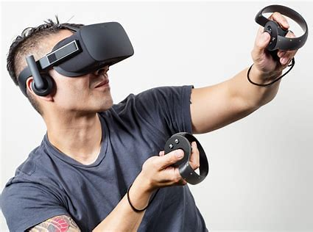
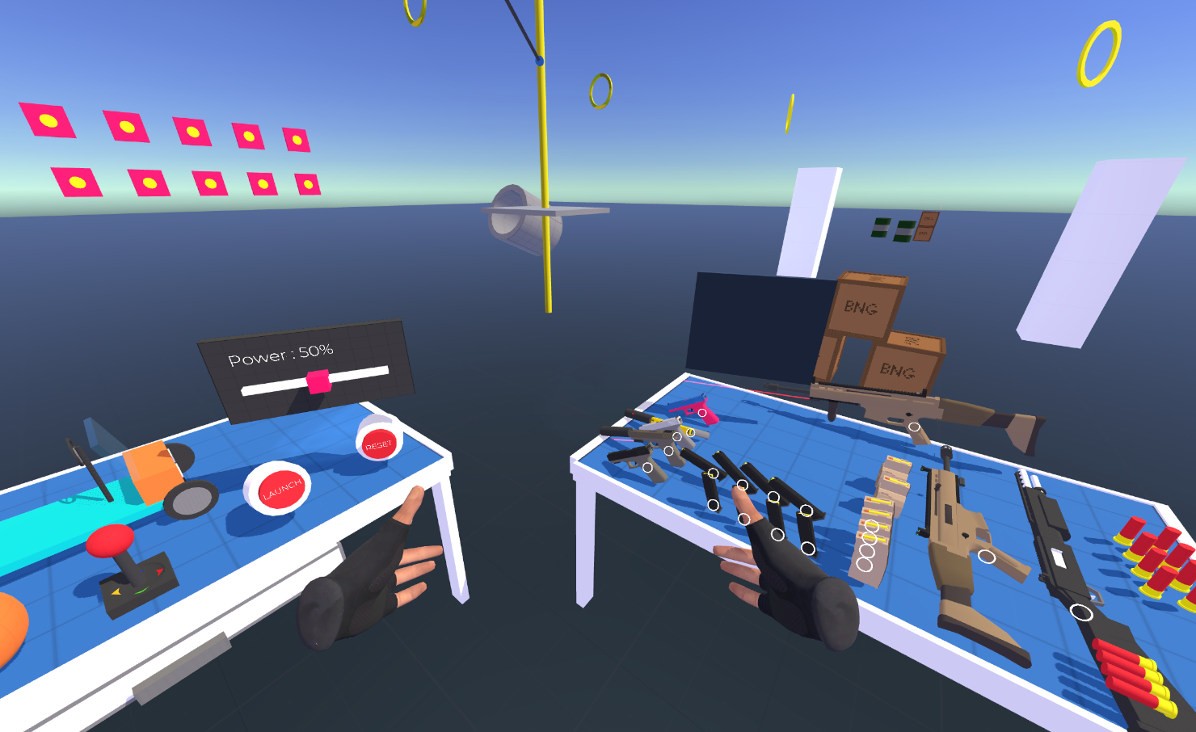
Introduction
Research Background
Most of the VR apps are developed by Unity3D (one of the most popular game engines). Undeniably, there are many bugs during the developing procedure.
VR apps testing and bug detection is labor-intensive and time-consuming
Notes:
VR研究背景：许多bug、人工检测困难且费事

Slide 3
Introduction
Motivation
SOTA automated testing tools:
exhibit limited performance in sophisticated scene exploration and VR interaction
no scalability and versatility : unable to provide a general VR tool to detect different types of VR apps
Notes:
场景探索能力差、没有通用性问题、无法解决线性和非线性任务、无法发现潜在问题

Slide 4
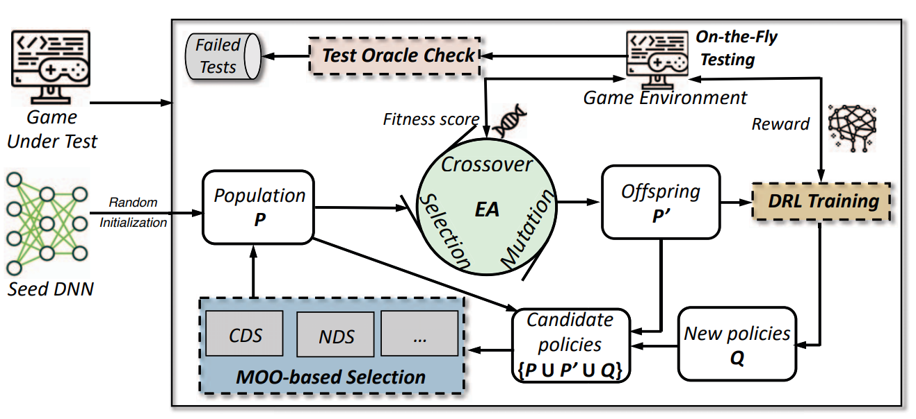
Existing Work 1
(ASE 19)Wuji
Only for specific types of games
Focus on game skills and player movement, without scene exploration
Fig. Wuji
Notes:
Wuji，是能用于动作游戏，且只能触发释放技能，没有场景探索能力 是基于演化强化学习的

Slide 5
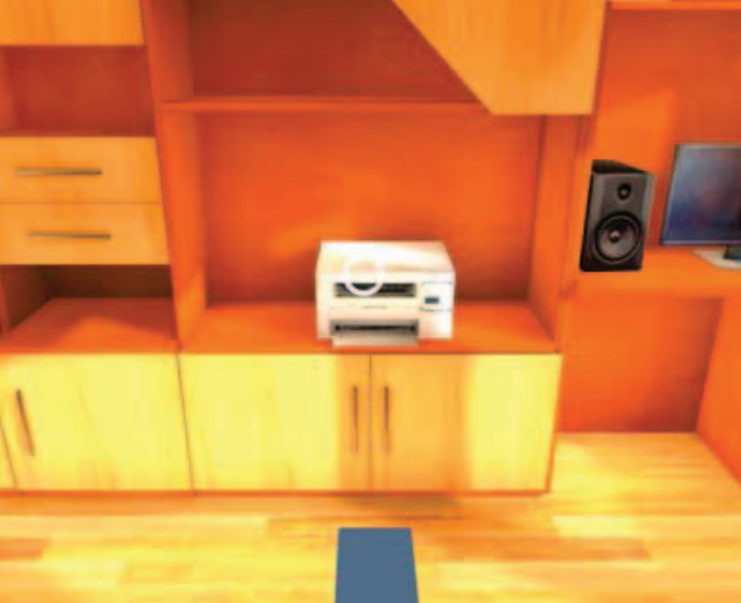
Existing Work 2
(ASE 23)VRGuide
Only can click
Poor performance in accessing complicated VR interaction, combinations of tasks
Data collection set is small and not leading-edge
Fig. VRGuide
Notes:
VRGuide，重点在于寻路优化，但是只能点击，没有复杂VR交互能力，数据集太陈旧且数量少

Slide 6
Workflow
Problem Target
Design a smart enough agent that can simulate a real player to explore the scene, interact with as many as possible entities, and trigger method codes to detect underlying bugs.
Improve evaluation metrics: Interactable Objects Coverage, Executable Line of Code (ELOC) Coverage, Method Coverage
Notes:
目标是设计一个足够聪明的智能体，从而能够提高这些指标

Slide 7
Workflow
Contribution and Novelty
Construction of an open-source VR data set
Model-based EAT (Entity, Action, Task) framework for better scalability and ability to process sophisticated interaction
Evaluation and case study to detect real-world bug

Slide 8
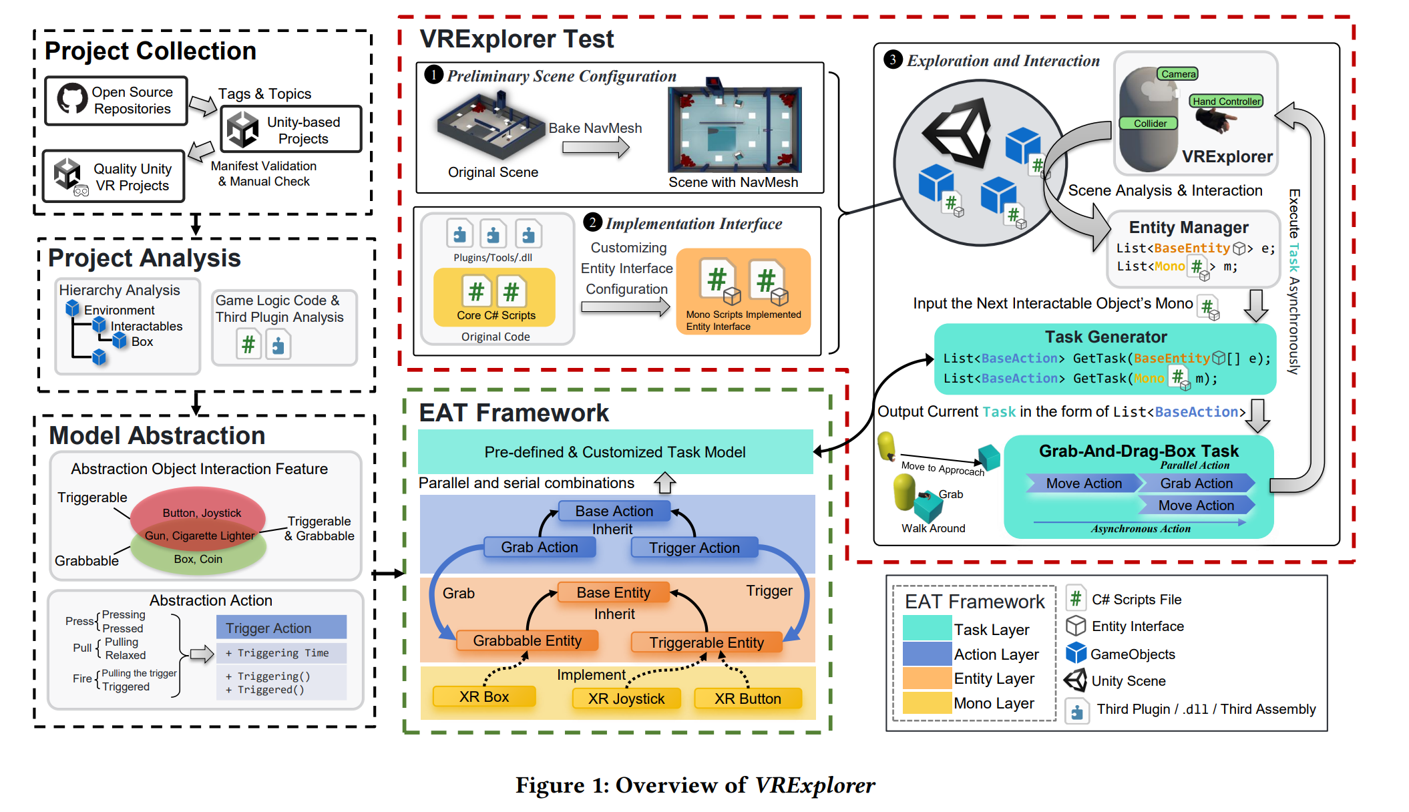
Workflow
Overview

Slide 9
Workflow
Project Collection and Analysis
Construct a Unity open-source VR project data set: 971 GitHub repos; After manifest validation and manual check, 104 quality repos
Bug characteristics analysis, root cause analysis, and general VR task pre-defined

Slide 10
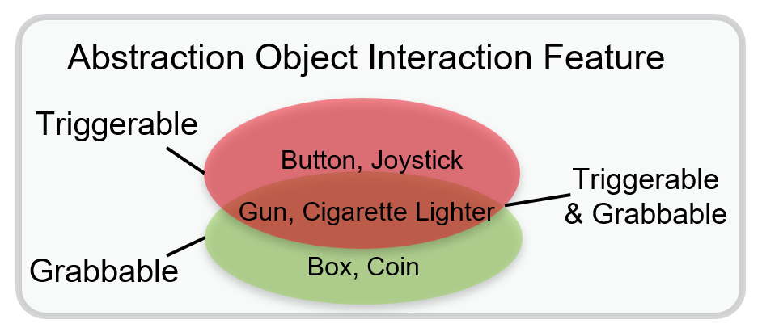
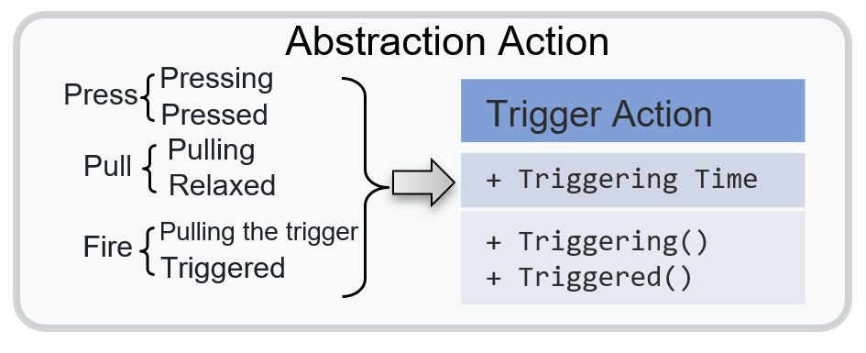
Workflow
Model Abstraction
Abstraction Action
Abstraction Object Interaction Feature

Slide 11
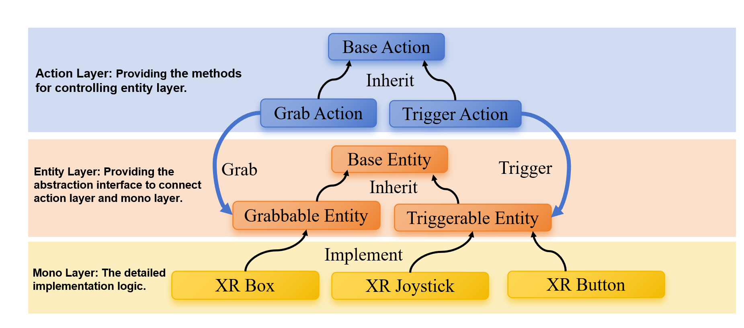
Workflow
Entity-Action-Task Framework
Base Entity interface for abstracting different VR MonoBehaviour Class
Base Action class for abstracting indivisible action of VRAgent
Task Generator for generating List<BaseAction> result of the input BaseEntity[];

Slide 12
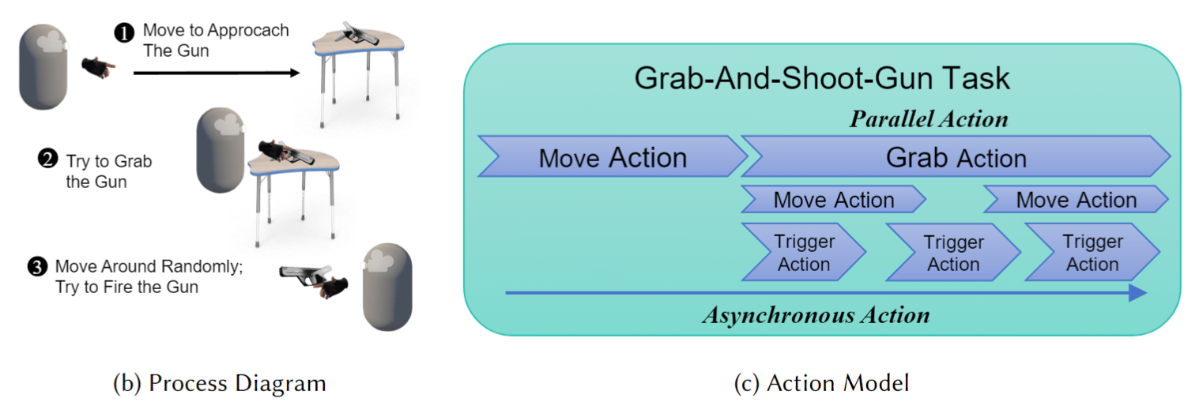
Workflow
Task Model
private List<BaseAction> GrabAndShootGunTask(
IGrabbableEntity grabbableEntity, ITriggerableEntity triggerableEntity){
List<BaseAction> task = new List<BaseAction>(){
new MoveAction(_navMeshAgent, moveSpeed, grabbableEntity.transform.position),
new GrabAction(leftHandController, grabbableEntity, new List<BaseAction>(){
new ParallelAction(new List<BaseAction>(){
new MoveAction(_navMeshAgent, moveSpeed, GetRandomTwitchTarget(transform.position)),
new TriggerAction(0.5f, triggerableEntity)
})
})
};
return task;
}

Slide 13
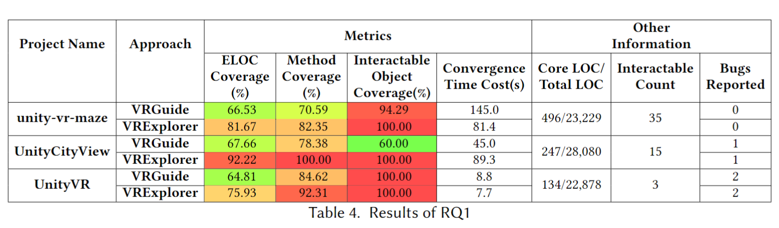
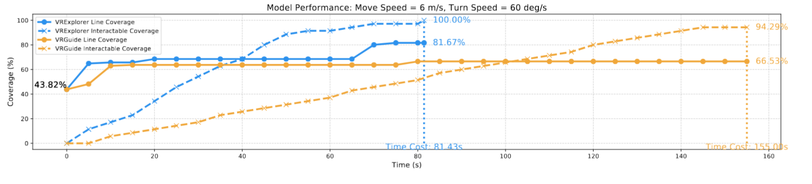
Experiment
RQ1: Code Coverage & Efficiency

Slide 14
